Slide 1
Digital Portfolio
STUDENT NAME: Indhumathi. S
REGISTER NO AND NMID: astvu24924924u09006
DEPARTMENT: BCA
COLLEGE:SSS college for women

Slide 2
PROJECT title
Student digital portfolio

Slide 3


AGENDA
Problem Statement
Project Overview
End Users
Tools and Technologies
Portfolio design and Layout
Features and Functionality
Results and Screenshots
Conclusion
Github Link
3/21/2024 Annual Review

Slide 4

PROBLEM STATEMENT
Students often struggle to showcase their skills, achievements, and projects using traditional paper-based methods, which are hard to update and share. A digital portfolio is needed to provide an organized, interactive, and easily accessible platform for students to present their academic and personal growth effectively

Slide 5

WHO ARE THE END USERS?
Teachers / Professors → if the portfolio is for academic purposes or assignments.
Employers / Recruiters → if it’s a career-oriented portfolio showing your skills, projects, and achievements.
Clients → if you are a freelancer or designer/developer showcasing your work.
Peers / Classmates → if it’s for collaboration, feedback, or sharing ideas.
Yourself → to track your own learning progress, growth, and achievements

Slide 6

TOOLS AND TECHNIQUES
Tools:
Canva, PowerPoint, Google Slides (for designing)
Adobe Photoshop, Illustrator, Figma (for creative work)
WordPress, Wix, Google Sites (for no-code websites)
GitHub (for developer portfolios)
Technologies:
Frontend: HTML, CSS, JavaScript
Frameworks: React, Angular, Vue
Backend: Node.js, PHP, Python (Django/Flask)
Database: MySQL, MongoDB, Firebase
Hosting: GitHub Pages, Netlify, Vercel, AWS

Slide 7
POTFOLIO DESIGN AND LAYOUT
Portfolio designs and layout refer to the way information is arranged and presented in a portfolio. Common designs include: Single-page / Scrolling layout Grid layout (projects shown in boxes) Gallery/Visual layout (images & creative work) Tabbed/Section-based layout (About, Skills, Projects, Contact)
7

Slide 8

PROJECT OVERVIEW
The Student Digital Portfolio is a web-based platform that allows students to showcase their personal details, academic achievements, skills, and projects in a structured and interactive format. It enables easy updates, multimedia integration, and sharing with teachers or recruiters, serving as a professional showcase of a student’s growth and capabilitlines

Slide 9
FEATURES AND FUNCTIONALITY
Features: Personal details (name, profile, contact info) Education & skills section Projects / Work samples Resume download option Attractive design & layout
Functionality: Easy navigation (menu, links, tabs) Interactive elements (buttons, animations) Search or filter (for projects/works) Responsive design (works on mobile & desktop) Online accessibility (shareable link/URL)

Slide 10
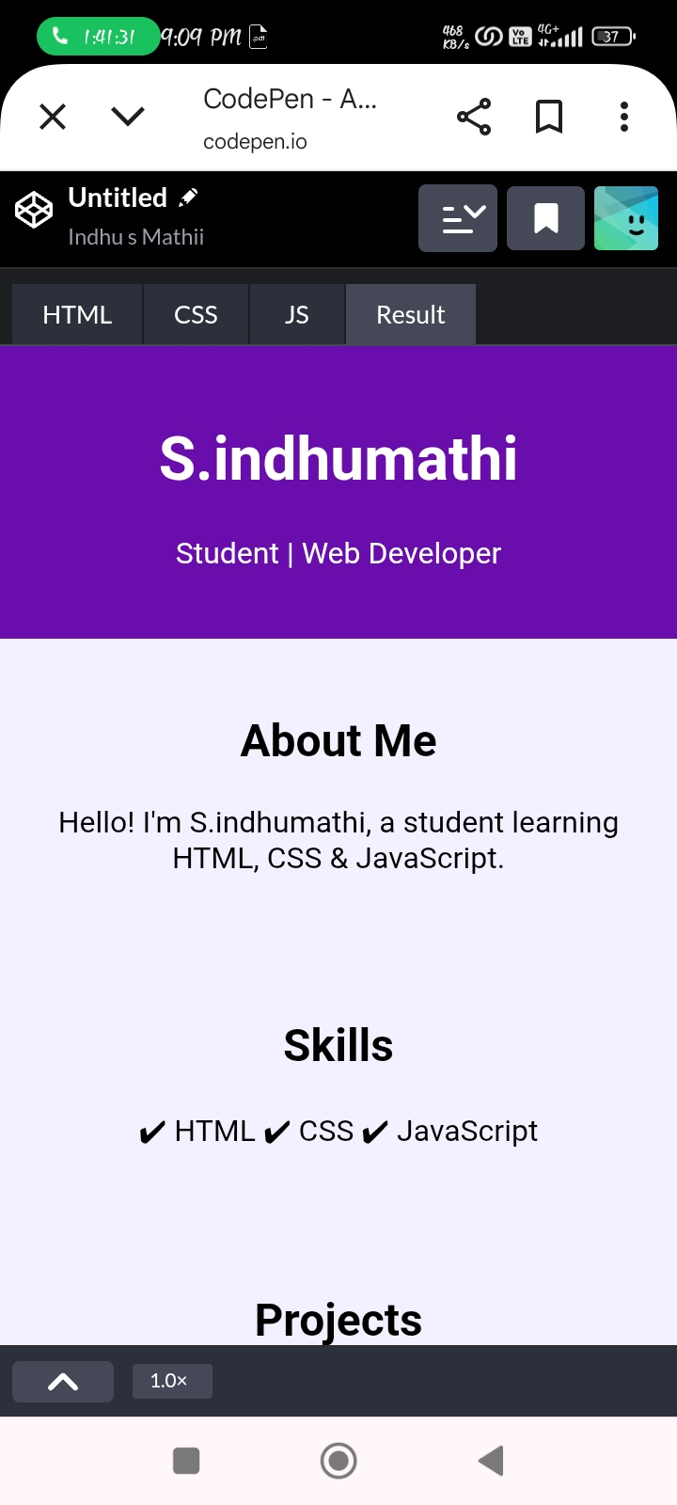
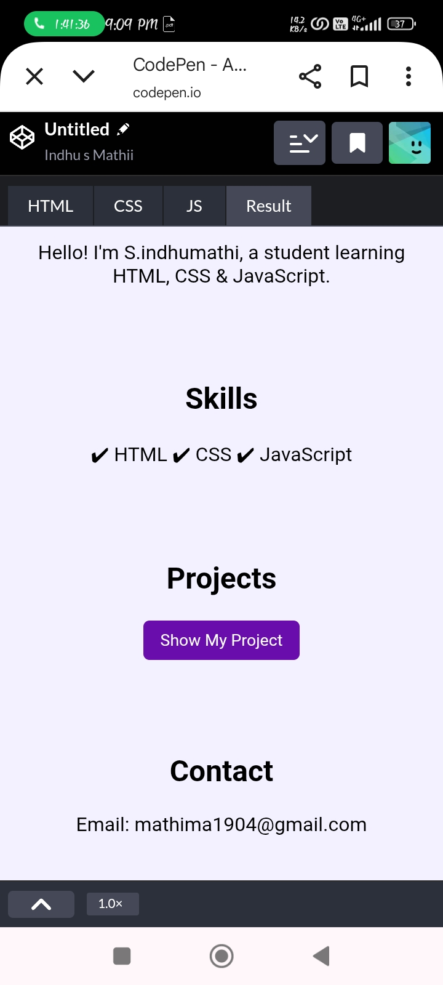

RESULTS AND SCREENSHOTS
3/21/2024 Annual Review
10

Slide 11
CONCLUSION
A digital portfolio is an effective way to showcase personal skills, achievements, and projects in an organized and professional manner. It helps students, professionals, and freelancers present their work to teachers, employers, or clients, and improves career and learning opportunities.
11

